Slide 1
PerfTest: Meeting Note (09/29/09)
Yoonki Song
Last Updated: Sep. 29, 2009

Slide 2
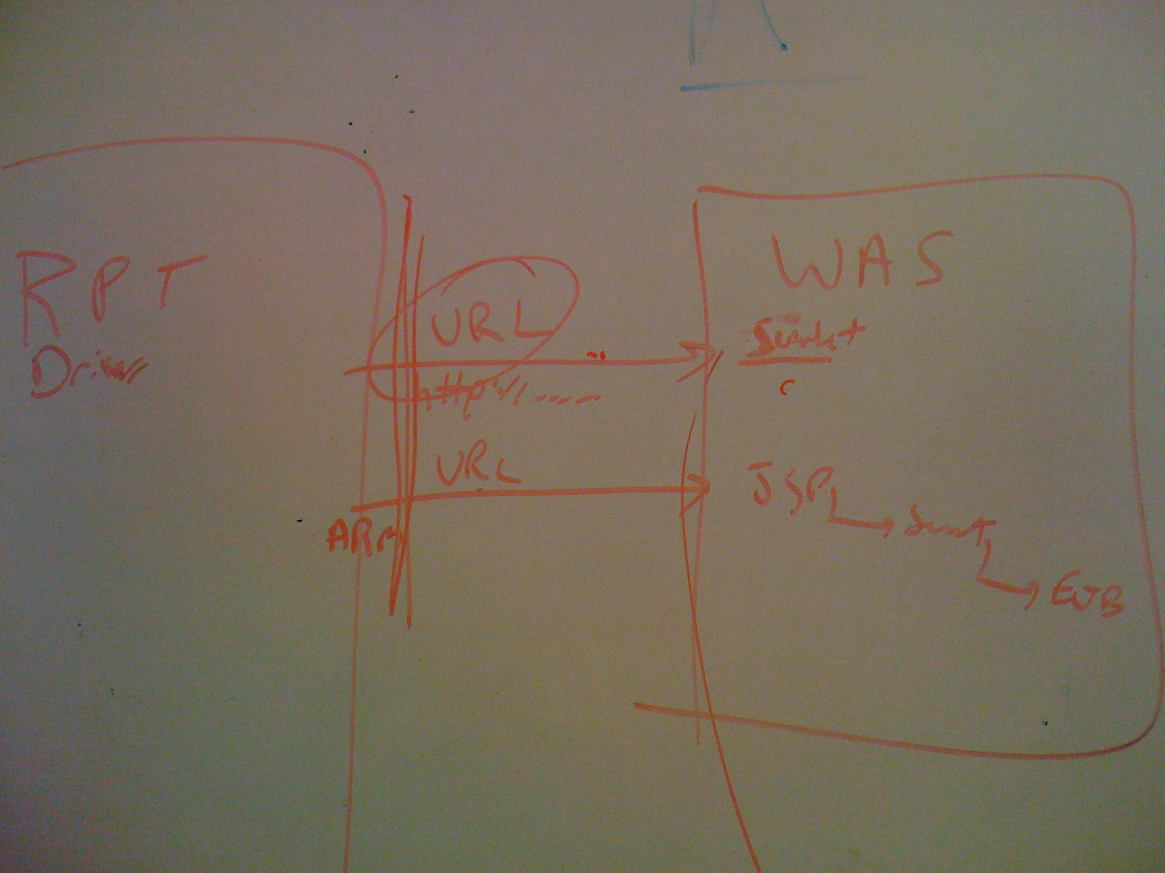
1 | 3
2 | 4
Servlet

Slide 3
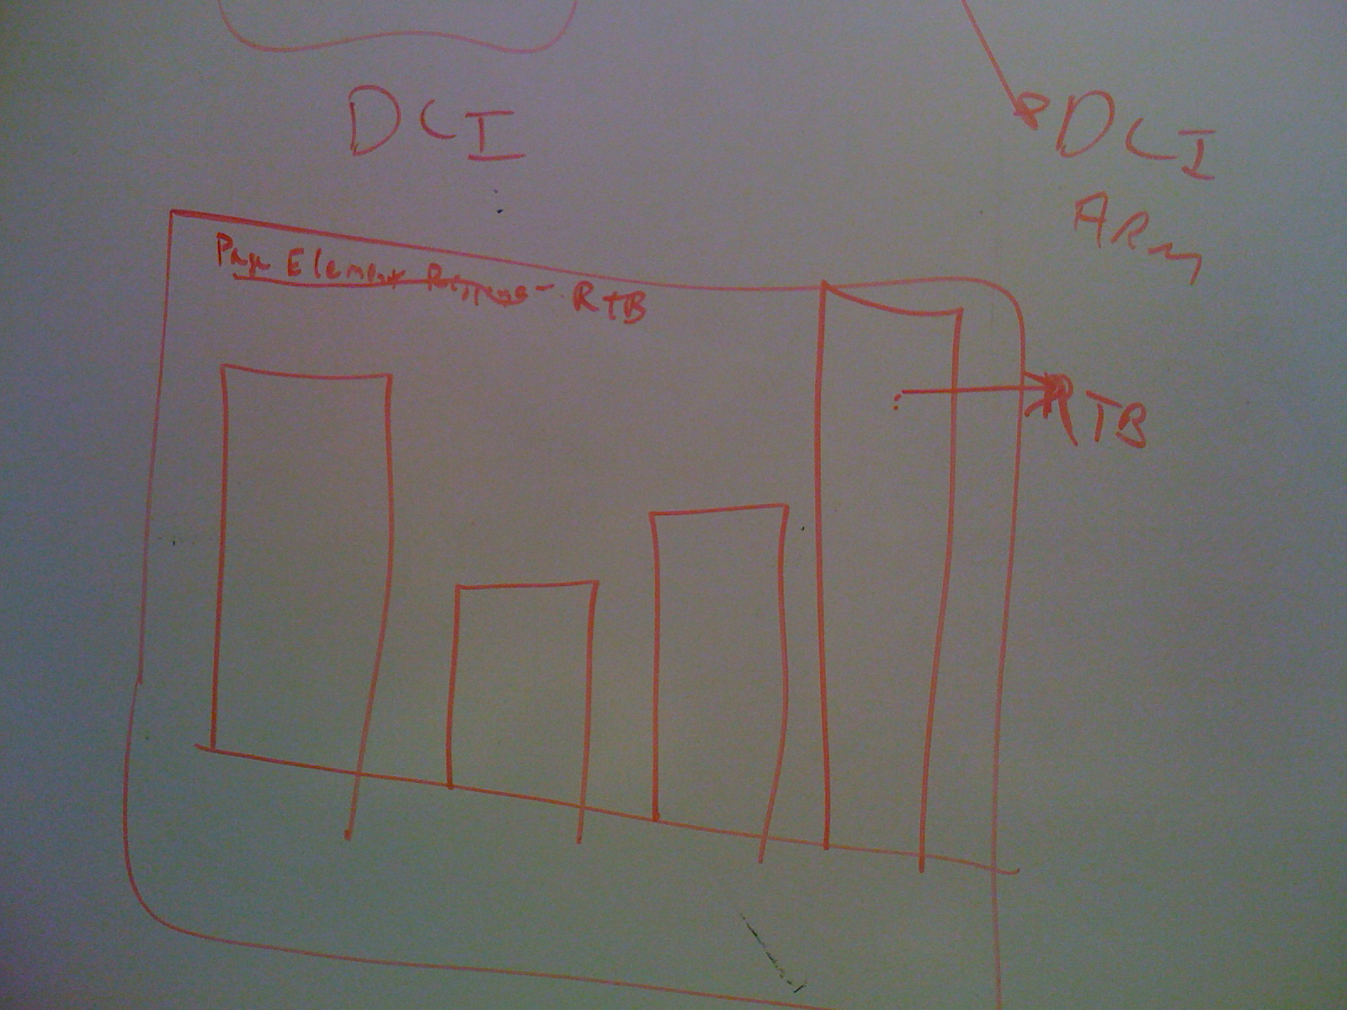
1 | 3
2 | 4
RTP Workbench
showing Performance Result
Response Time
Breakdown

Slide 4
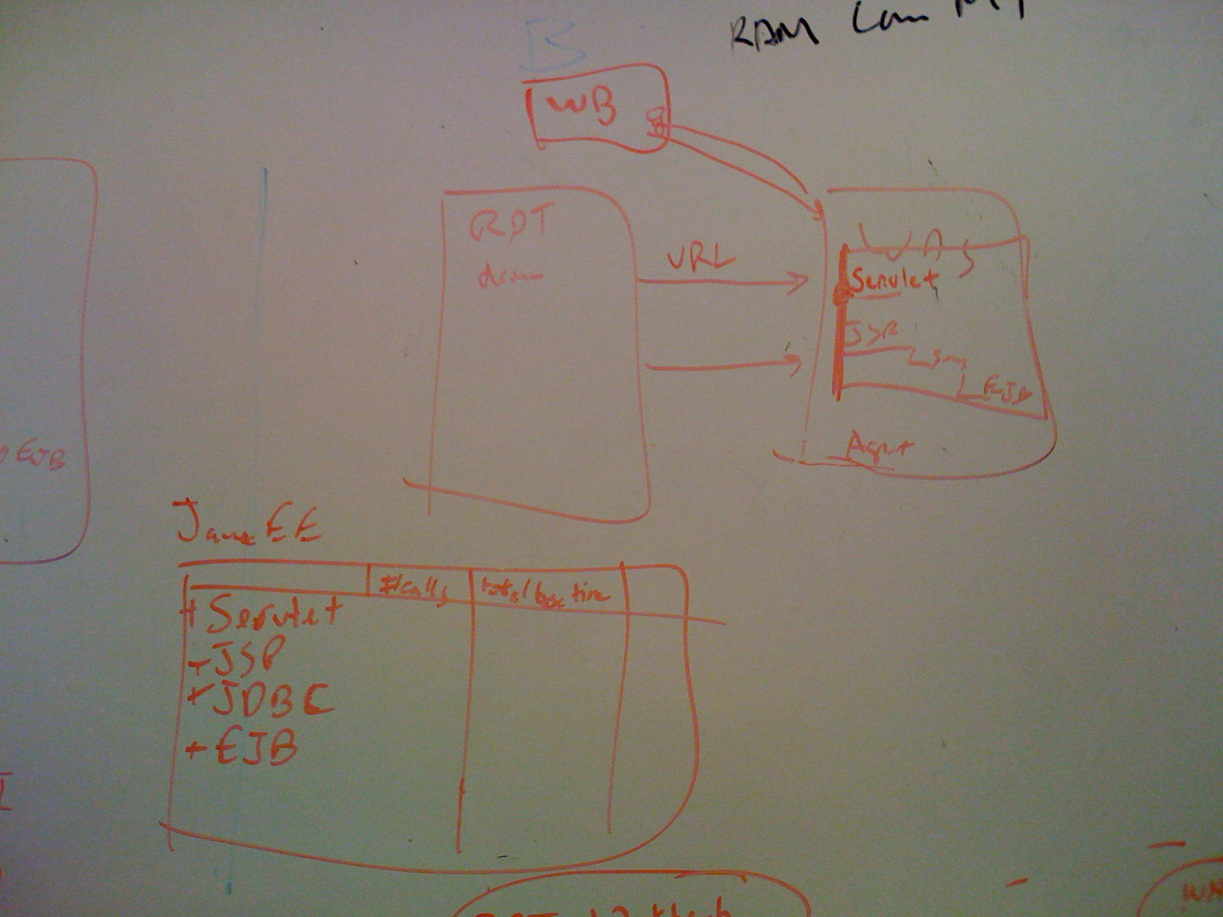
1 | 3
2 | 4
RPT Workbench
Trace data collected from Agent Controller does not contain the URL information
RPT Driver

Slide 5
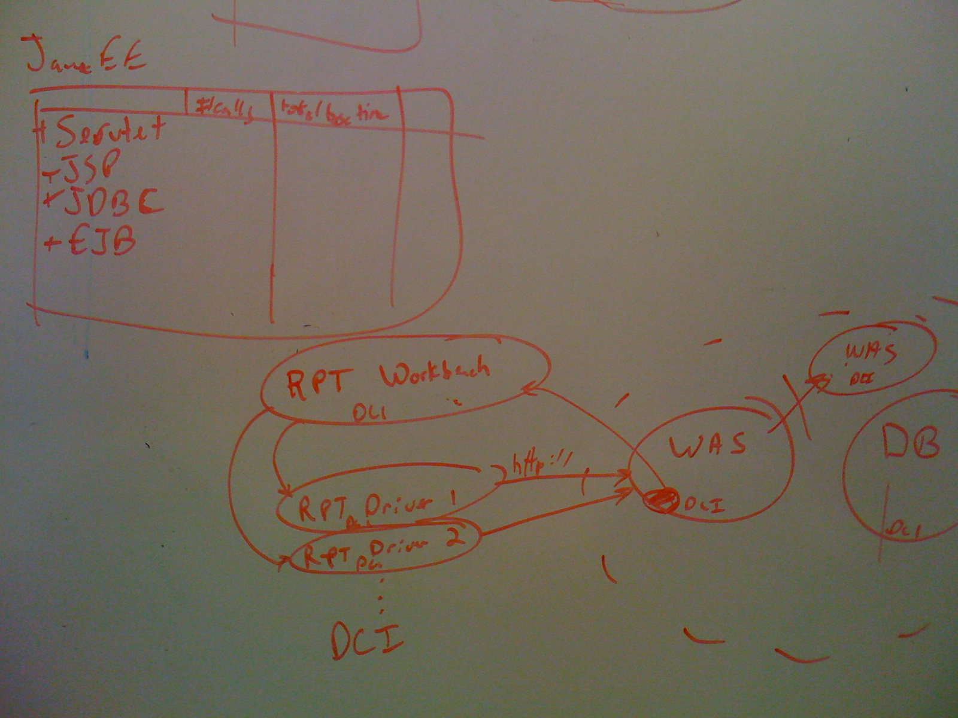
1 | 3
2 | 4

